Slide 1
Helical Gears

Slide 2
Helical Gears
The teeth of helical gears are arranged so that they lie at an angle with respect to the axis of the shaft.
The angle, called the helix angle, can be virtually any angle.
Typical helix angles range from approximately 10° to 30°, but angles up to 45° are practical.
The helical teeth operate more smoothly than equivalent spur gear teeth, and stresses are lower.

Slide 3


Slide 4
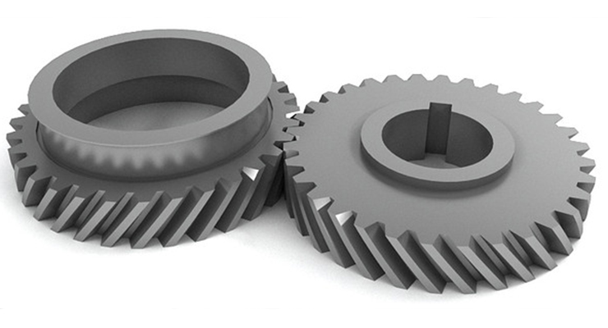
One disadvantage of helical gears is that an axial force, called a thrust force, is generated in addition to the driving force that acts tangent to the basic cylinder on which the teeth are arranged.

Slide 5
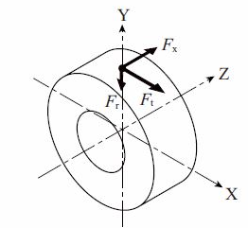
Forces acting on Helical gears
When the gear mesh transmits power, forces act on the gear teeth. As shown in Figure, if the Z-axis of the orthogonal 3-axes denotes the gear shaft, forces are defined as follows:
1) The force that acts in the X-axis direction is defined as the tangential force Ft (N) 2) The force that acts in the Y-axis direction is defined as the radial force. Fr (N) 3) The force that acts in the Z-axis direction is defined as the axial force Fx (N) or thrust .

Slide 6
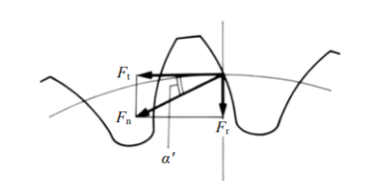
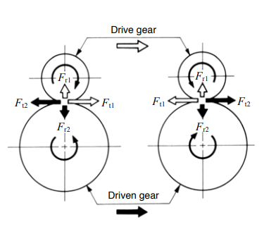

Slide 7
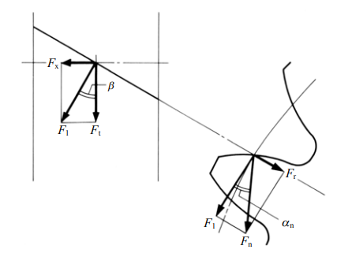

Slide 8
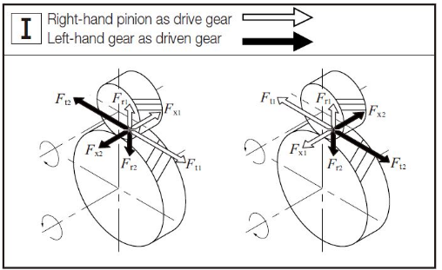
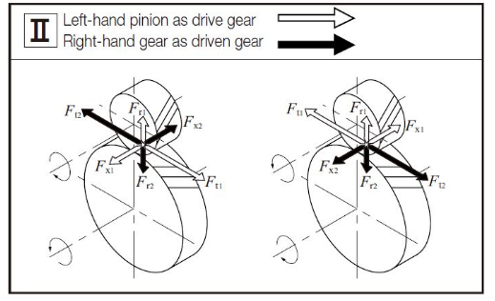
Direction of Forces acting on a Helical Gear Mesh

Slide 9
Helical Gear Geometry
On helical gears, the teeth are inclined at an angle with the axis, that angle being called the helix angle.
The helix for a given gear can be either left-hand or right-hand.
Parallel or crossed arrangement.

Slide 10
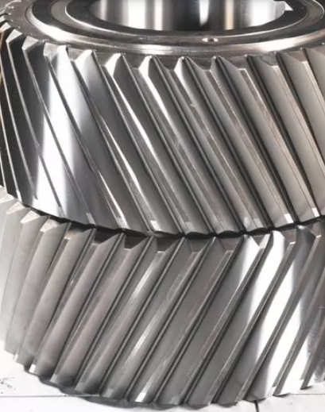
Gear is right or left hand?
Place the radial direction of the gear horizontally with the ground,
It is right-handed if it slopes from upper right to lower left,
as shown in ///;
Left-handed is tilted from top left to bottom right, as indicated
by \\\.

Slide 11
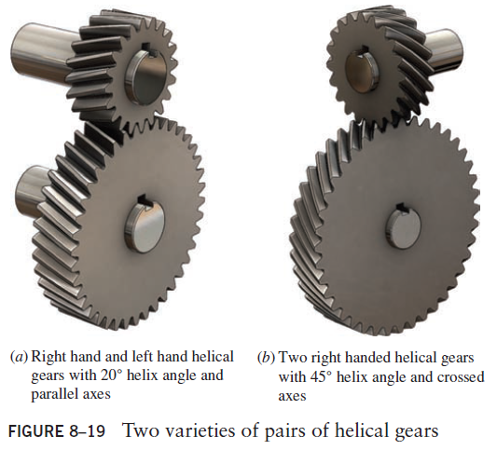
Helical Gears

Slide 12
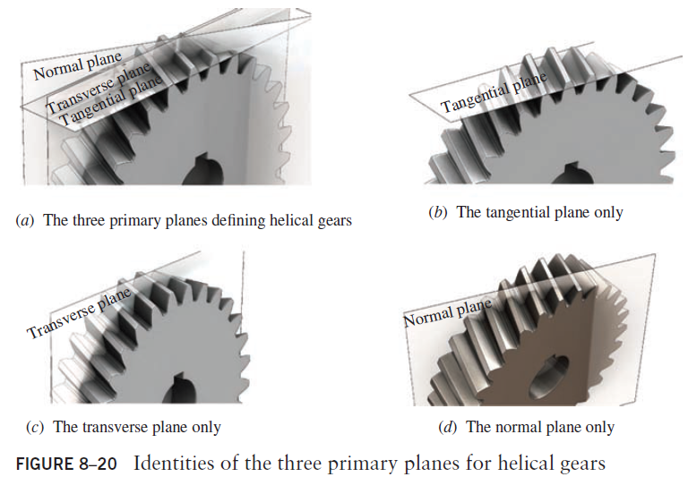
Primary Planes for Helical Gears
The three primary planes of a helical gear are illustrated

Slide 13
Primary Planes for Helical Gears
The tangential plane is tangent to the pitch diameter (pitch circle) of the helical gear and is also called the pitch plane.
The transverse plane is perpendicular to the axis of the helical gear and the tangential plane.
The normal plane is perpendicular to the tooth and the tangential plane.

Slide 14
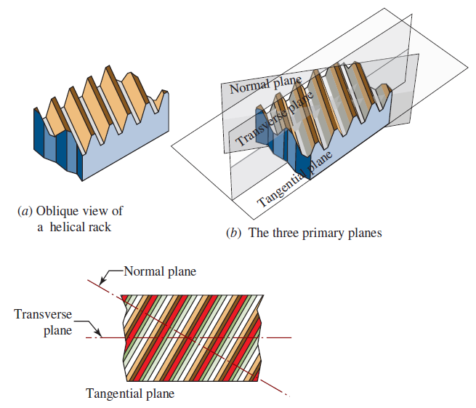
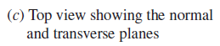

Slide 15
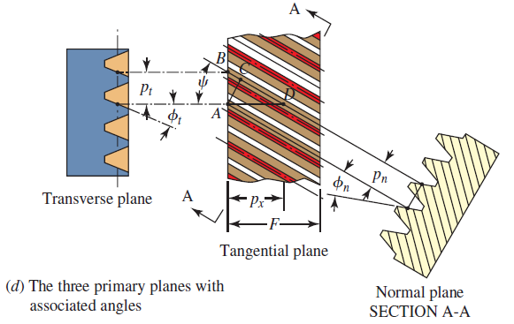

Pressure Angles for Helical Gears
In design of a helical gear, there are three angles of interest, (1) the helix angle, $ψ$;(2) the normal pressure angle, $φ_{n}$; and (3) the transverse pressure angle, $φ_{t}$.

Slide 16
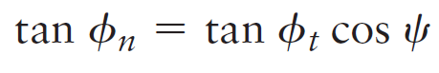
Pressure Angles for Helical Gears
Designers must specify the helix angle and one of the two pressure angles. The other pressure angle can be computed from the following relationship:

Slide 17
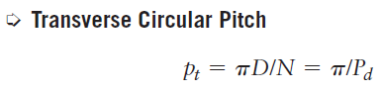

Pitches for Helical Gears
Transverse circular pitch, p_{t} . The transverse circular pitch is the distance from a point on one tooth to the corresponding point on the next adjacent tooth, measured at the pitch line in the transverse plane.

Slide 18
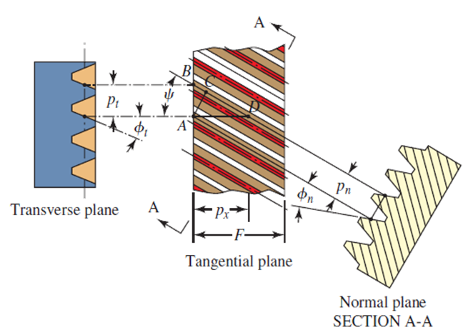
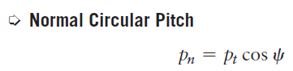
Pitches for Helical Gears
Normal Circular Pitch, p_{n}. Normal circular pitch is the distance between corresponding points on adjacent teeth measured on the pitch surface in the normal direction.

Slide 19
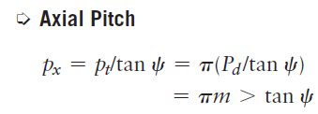
Pitches for Helical Gears
Axial Pitch, p_{x}. Axial pitch is the distance AD between corresponding points on adjacent teeth, measured on the pitch surface in the axial direction.

Slide 20
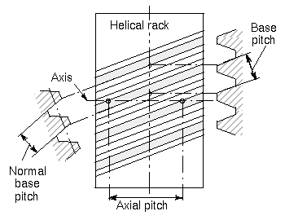

Slide 21
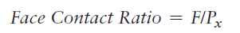
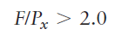
Face Contact Ratio
It is necessary to have at least two axial pitches in the face width to have the benefit of full helical action and its smooth transfer of the load from tooth to tooth.
The face contact ratio is also called the helical overlap. Then we can check a given design to ensure that

Slide 22
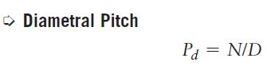
Pitches for Helical Gears
Diametral Pitch, P_{d}. Diametral pitch is the ratio of the number of teeth in the gear to the pitch diameter.

Slide 23
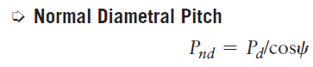
Pitches for Helical Gears
Normal Diametral Pitch, P_{nd}. Normal diametral pitch is the equivalent diametral pitch in the plane normal to the teeth:

Slide 24
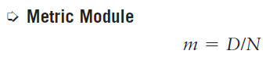
Helical Gears
Metric Module, m. As stated for spur gears, the metric module is essentially the inverse of the diametral pitch with the value reported in mm.

Slide 25
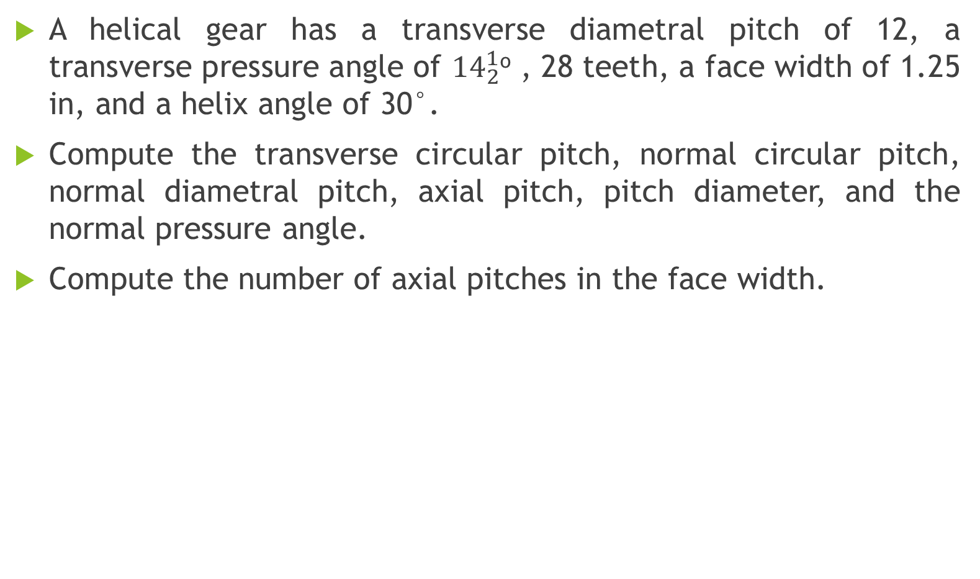
Example Problem
A helical gear has a transverse diametral pitch of 12, a transverse pressure angle of ${14}_{2}^{1}$º , 28 teeth, a face width of 1.25 in, and a helix angle of 30°.
Compute the transverse circular pitch, normal circular pitch, normal diametral pitch, axial pitch, pitch diameter, and the normal pressure angle.
Compute the number of axial pitches in the face width.

Slide 26
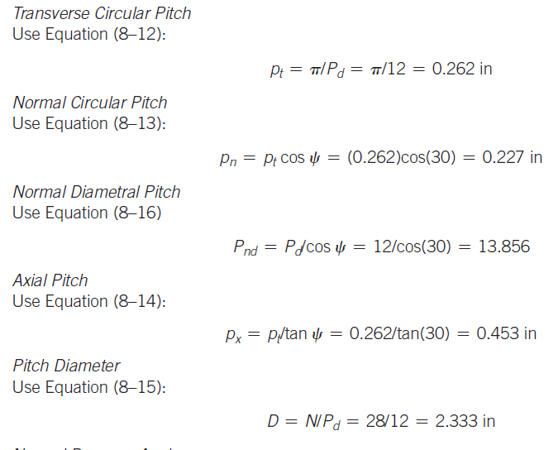

Slide 27
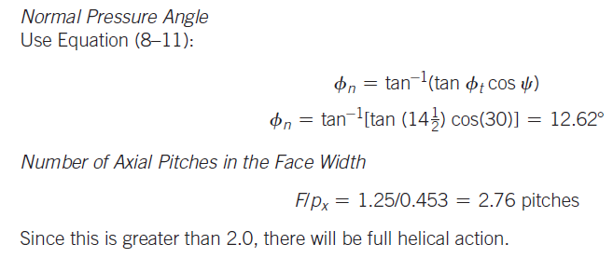

Slide 28

BEVEL GEARS AND WORM GEARS
Chapter 8- Bevel and Worm Gear Geometry (Self study)

